Slide 1
딥러닝 세미나
- Recurrent Neural Network
융합데이터 분석 연구실
20180219

Slide 2
Recurrent Neural Network
RNN은 기본적인 feed forward neural network 구조에 이전 시간 (t-1)의 hidden layer의 ouput을 다음 시간 (t)에 hidden layer 로 다시 집어 넣는 경로가 추가된 형태이다.
Slid credit: 패스트 캠퍼스 – 딥러닝 영상인식 강의자료 by Solaris

Slide 3
Unfolded Recurrent Neural Network
RNN을 다른 관점으로 바라보면, 일반적인 Neural Networks을 펼친(Unfolded) 형태로 생각할 수 있다.
예를 들어, 5개의 단어로 이루어진 문장을 RNNs의 Input으로 사용한다면, 아래와 같이 순환연결이 없는 Neural Networks를 5층(5-Layer) 쌓은 것으로 바라볼 수 있다.
Vector!!
Slide credit: 패스트 캠퍼스 – 딥러닝 영상인식 강의자료 by Solaris Picture credit : hands-on-machine learning with Scikit-learn and tensorflow(오른쪽)

Slide 4
Unfolded RNN 예시
Picture credit : Andrej Karpathy’s Blog, http://karpathy.github.io/2015/05/21/rnn-effectiveness/

Slide 5
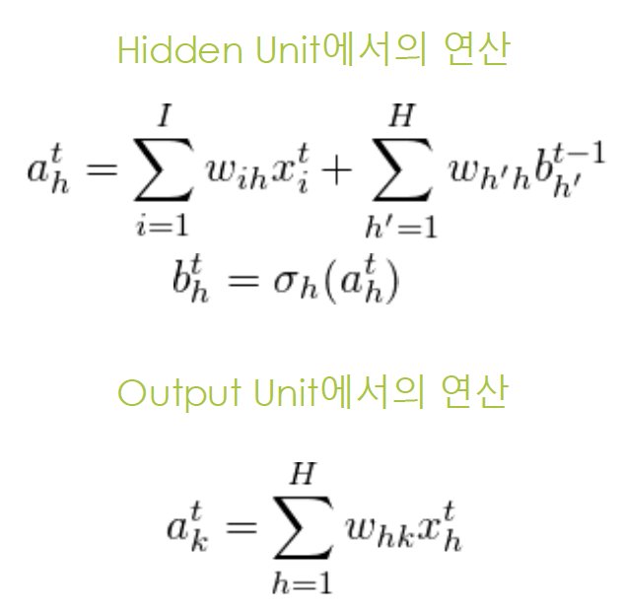
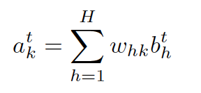
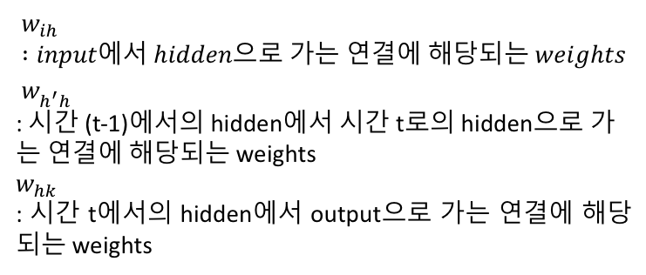
Recurrent Neural Network에서의 연산
Activation –
Sigmoid or softmax
$$w_{ih} :input에서 hidden으로 가는 연결에 해당되는 weights \\ w_{h^{′}h}^{}$$
: 시간 (t-1)에서의 hidden에서 시간 t로의 hidden으로 가는 연결에 해당되는 weights
$$w_{hk}$$
: 시간 t에서의 hidden에서 output으로 가는 연결에 해당되는 weights
Source : 패스트 캠퍼스 – 딥러닝 영상인식 강의자료 by Solaris supervised sequence labelling with RNNs, Alex Graves.

Slide 6
RNN 특징 1 - Memory Cell
Since the output of a recurrent neuron at time step t is a function of all the inputs from previous time steps, you could say it has a form of memory
A part of a RNN that preserves some state across time steps = a memory cell ( simply, cell )
Therefore, an RNN can map from the entire history of previous inputs to each output
따라서 앞에서 얻은 정보가 뒤에서 얻은 데이터와 연관관계를 가지는 데이터를 다룰 때, 매우 강력한 효과를 발휘한다
인간의 언어(Natural Language)는 앞뒤 문맥(Context)를 가지고 있기 때문에 RNN을 적용하기 매우 적합한다. 예를 들어 ‘푸른 하늘에 OO이 떠있다.＇라는 문장에서 OO에 들어갈 단어를 예측하고자 한다면, 앞의 정보인 푸른, 하늘이라는 단어를 통해 ‘구름’이라는 것을 예측할 수 있다.
Source : 패스트 캠퍼스 – 딥러닝 영상인식 강의자료 by Solaris hands on machine learning with scikit learn and tensorflow Supervised Sequence Labelling with Recurrent Neural Networks, Alex Graves.

Slide 7
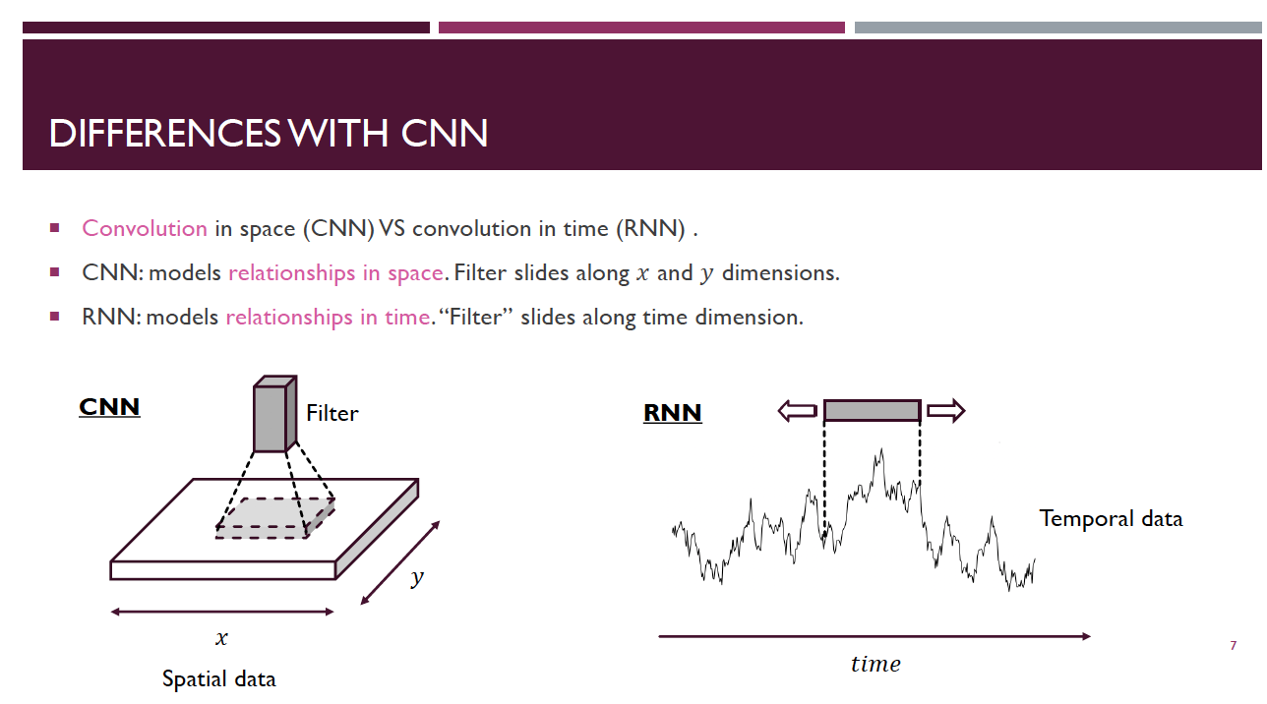
Differences with CNN
Slide Credit : https://www.sintef.no/contentassets/9689621c8cda44d9b2bc91c5fba21135/bianchi.pdf

Slide 8
RNN 특징 2 – shared weights at each time step t
'shared weights’ comes from thinking RNNs as feedforward networks unrolled across time
Suppose RNN whose weights are a time-varying function ( keep the ability to process vari-able length sequences)
Then, the number of parameters would grow linearly with the number of time steps
Even if you add the massive computational resources to run it and the massive data to constrain it, for long sequences, it would probably be easy to get overfitting.
Also, it would be hard to compute gradient at each time step t
➔ Therefore, sharing weights for any sequential length can generalize the model well
Source : https://stats.stackexchange.com/questions/221513/why-are-the-weights-of-rnn-lstm-networks-shared-across-time A gentle tutorial of recurrent neural network with error propagation, Gang Chen

Slide 9
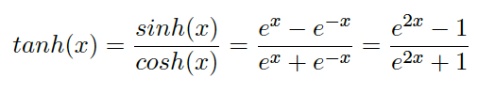
RNN 특징 3 (?) - hyperbolic tangent activation function
대부분의 rnn의 구조가 hidden layer부분에서 hyperbolic tangent activation function을 쓴다.
Relu를 쓰는 구조도 가끔 논문에서 찾아볼 수 있었지만 그래도 대부분 tanh을 쓴다.
이유를 찾아보려고 했지만, google scholar검색에서도, 구글링에서도 명확한 대답을 찾을 수가 없었다. 그 중에서 그럴 듯한 설명을 한 slide를 발견하였다.

Slide 10
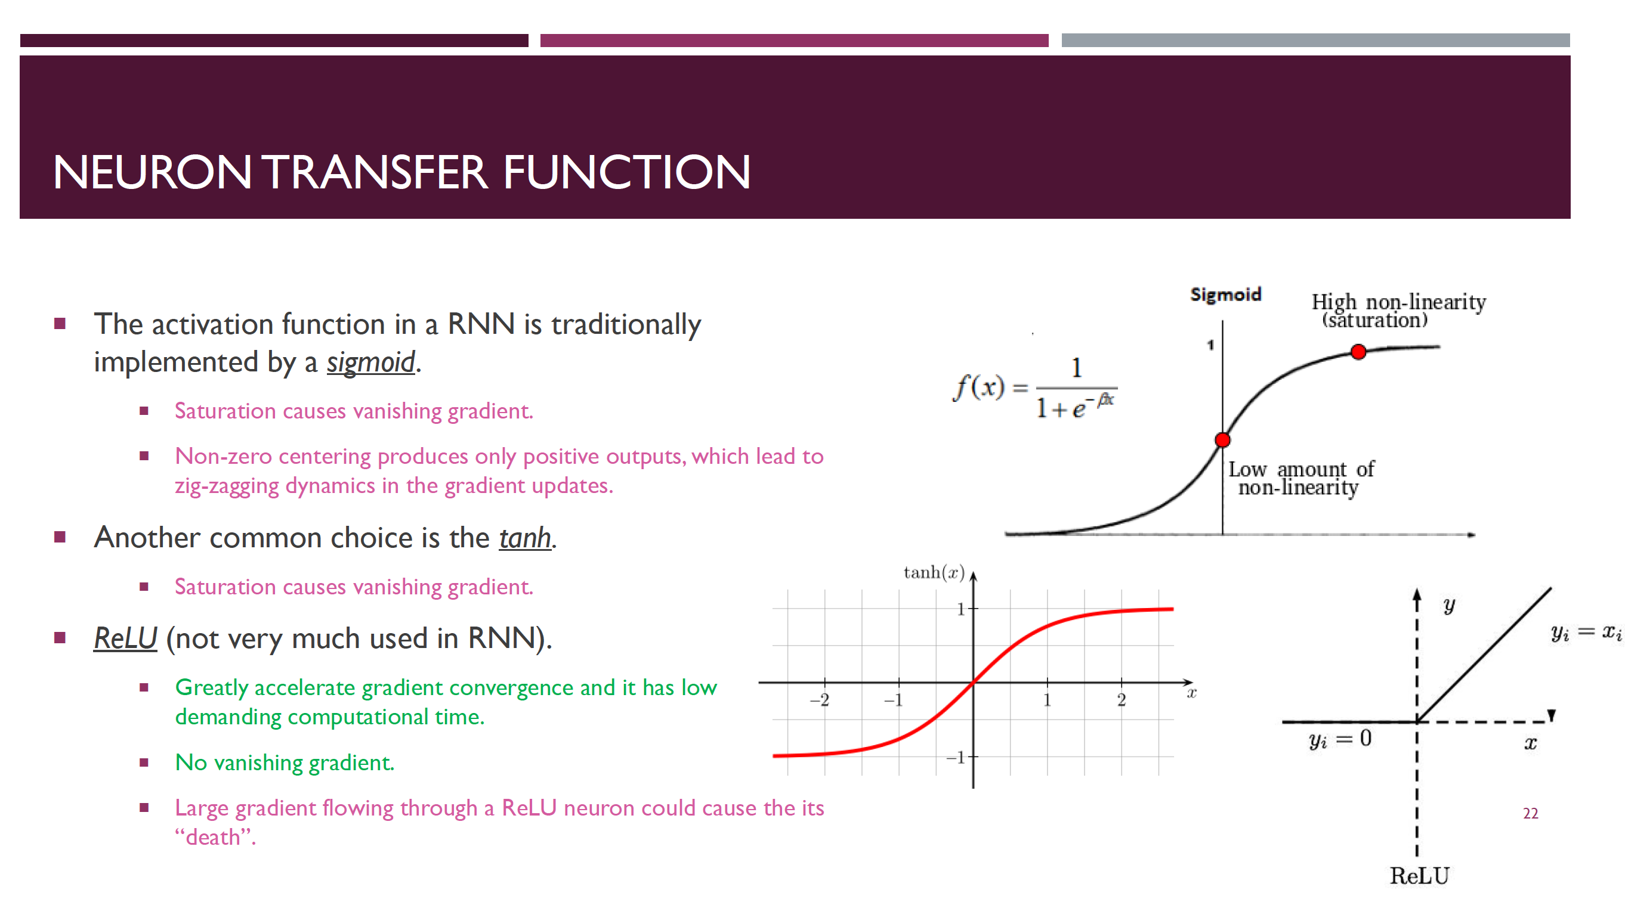
RNN 특징 3 (?) - hyperbolic tangent activation function
Slide Credit : https://www.sintef.no/contentassets/9689621c8cda44d9b2bc91c5fba21135/bianchi.pdf

Slide 11
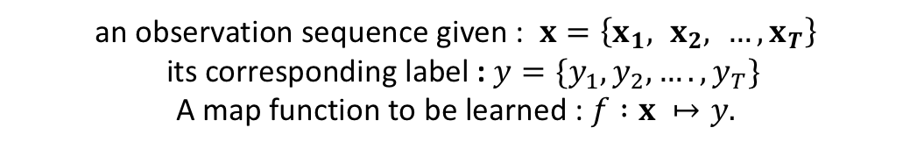
Sequence Labelling - Sequential data
Time series data and Ordered data structures - Time Series Data ex) speech or video data, daily prices of stocks, etc. - Ordered data structures ex) text and sentence for handwriting recognition, genes, etc.
Sequence labelling i.e. classify all items in a sequence.
an observation sequence given : $x=\left\{x_{1}, x_{2}, …, x_{T}\right\}$ its corresponding label : $y=\{y_{1},y_{2},…. , y_{T}\}$
A map function to be learned : $f :x ↦y.$
Source : A Gentle Tutorial of Recurrent Neural Network with Error Backpropagation, Gang Chen

Slide 12
Sequence labelling
Top-left : - sequence to sequence labelling - ex) predicting time series such as stock prices
Top-right: - sequence to vector network - ex) input as a sequence of words co-rresponding to movie review, output as a sentiment score (e.g -1[hate] to +1[love])
Bottom-left: - vector-to-sequence network - input : image, output : caption
Bottom-right: - sequence to vector network - traslating
Source : hands on machine learning with scikit learn and tensorflow

Slide 13
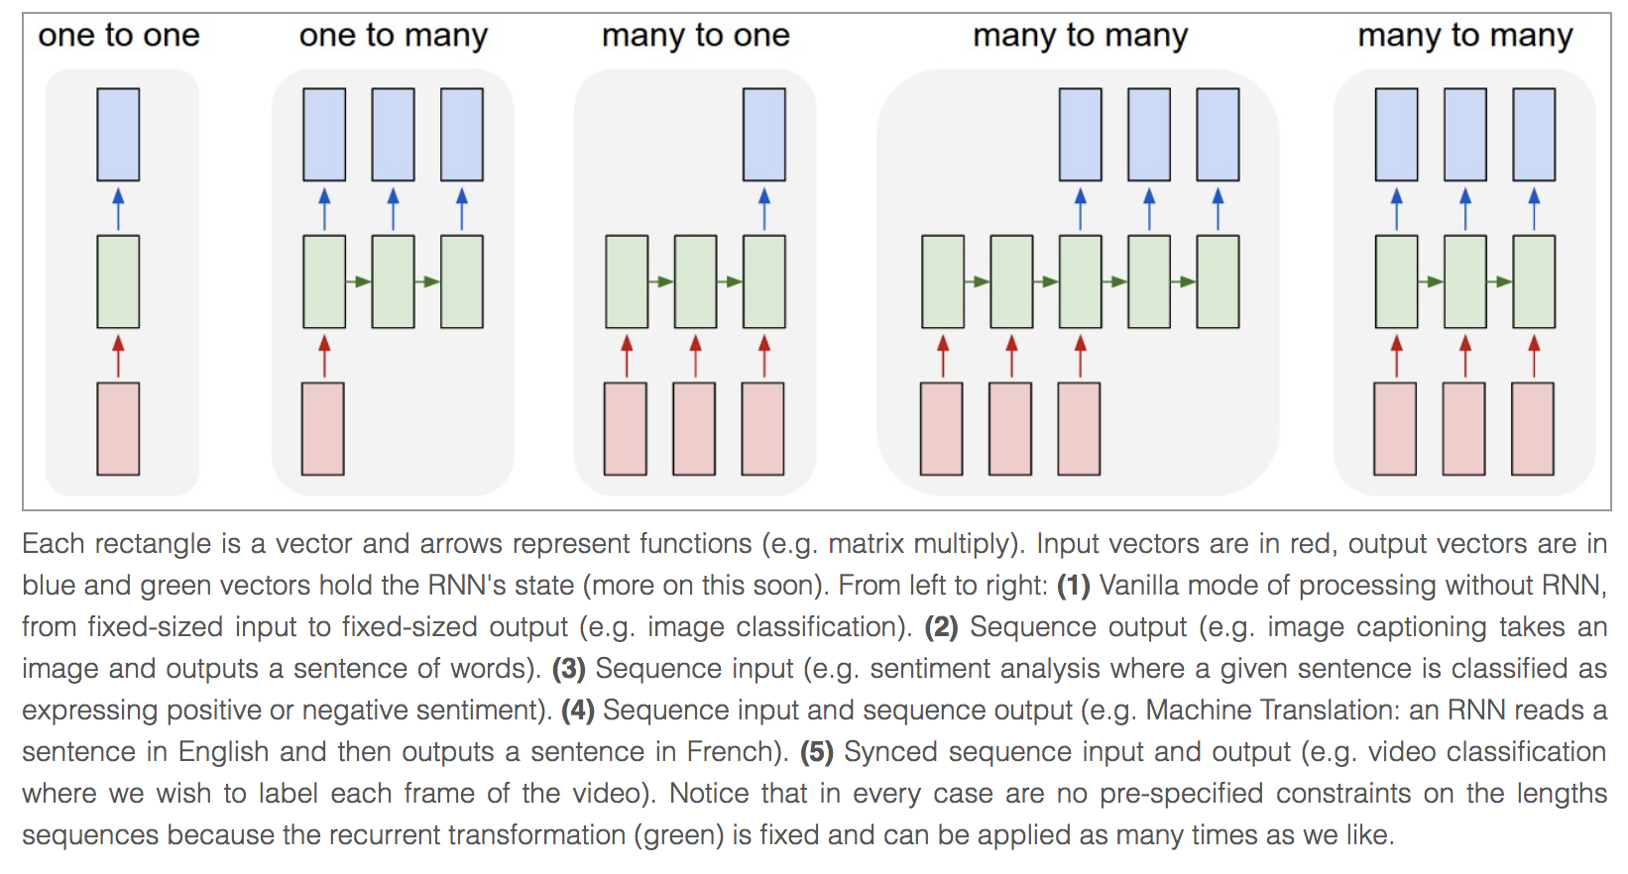
Sequence labelling
Source : Andrey Karpathy;s Blog, http://karpathy.github.io/2015/05/21/rnn-effectiveness/

Slide 14
Backpropagation Through Time(BPTT)
위와 같은 특성들 때문에, RNNs를 학습시키기 위해서는 기존에 사용하던 backpropagation 알고리즘과는 조금은 다른 방법이 필요하다.
이를 BackPropagation Through Time(BPTT) 알고리즘 이라고 부른다.
아래와 같이 펼쳐진 형태의 RNNs의 구조를 생각해 보자.
Source : 패스트 캠퍼스 – 딥러닝 영상인식 강의자료 by Solaris

Slide 15
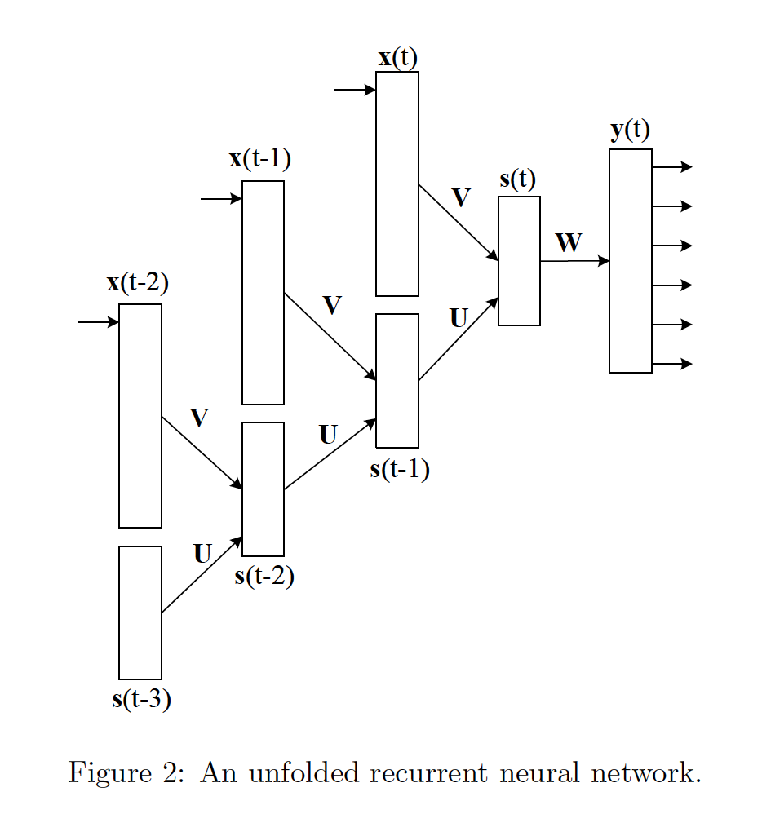
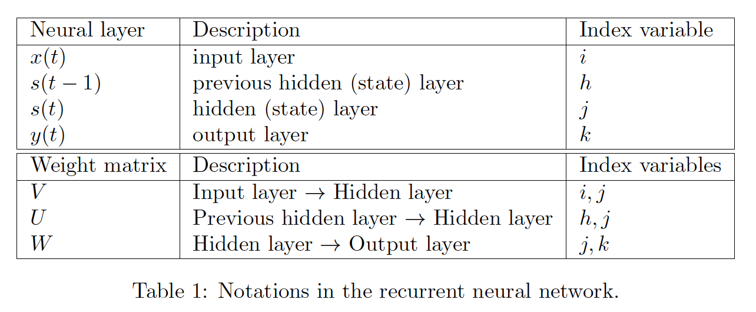
Back Propagation Through Time
Source : BackPropagation Through Time, Jiang Guo, 2013

Slide 16
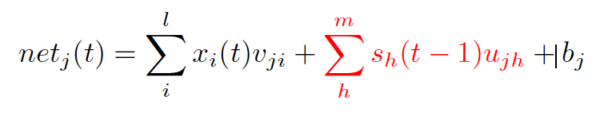
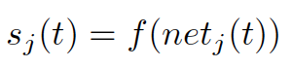
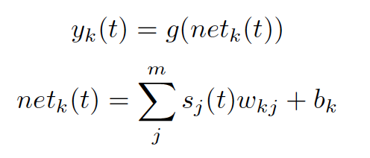
Back Propagation Through Time
Input layer → Hidden layer
Hidden layer → Output layer
Source : BackPropagation Through Time, Jiang Guo, 2013

Slide 17
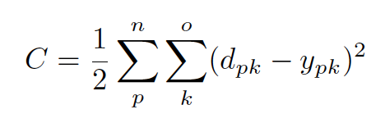
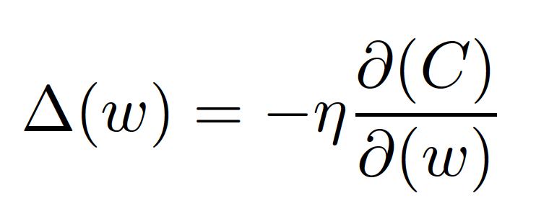
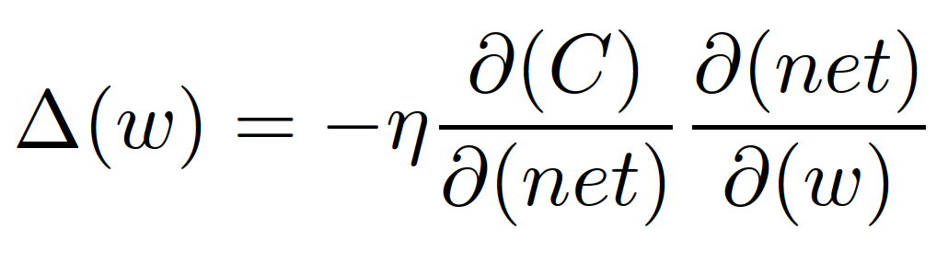
Back Propagation Through Time
Input layer → Hidden layer
Cost Function
- d : desired output - n : the # of training samples - o : the # of output units
Hidden layer → Output layer
Gradient
Source : BackPropagation Through Time, Jiang Guo, 2013

Slide 18
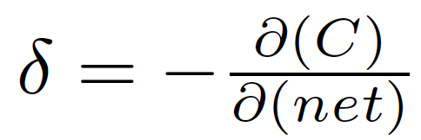
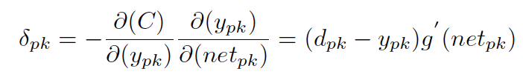
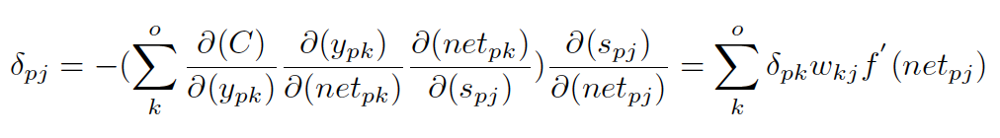
Back Propagation Through Time
Source : BackPropagation Through Time, Jiang Guo, 2013
Input layer → Hidden layer
Hidden layer → Output layer
Error (definition)
Cost Function
For output nodes:
- d : desired output - n : the # of training samples - o : the # of output units
For hidden nodes:
Gradient

Slide 19
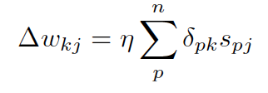
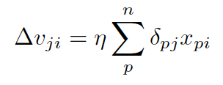
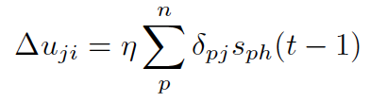
Back Propagation Through Time
Source : BackPropagation Through Time, Jiang Guo, 2013
Input layer → Hidden layer
W change (hidden→ output )
Hidden layer → Output layer
Error (definition)
V change (input → hidden )
For output nodes:
Cost Function
For hidden nodes:
U change (hidden → hidden )
- d : desired output - n : the # of training samples - o : the # of output units
Gradient

Slide 20
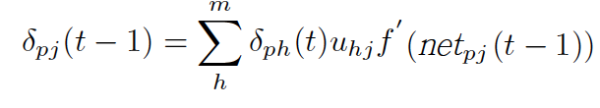
Back Propagation Through Time
Source : BackPropagation Through Time, Jiang Guo, 2013
Error in hidden layer at time t
Error in hidden layer at time t-1
Errors are propagated backward from t to t-1, t-2, t-3, t-4, …. t-T…

Slide 21
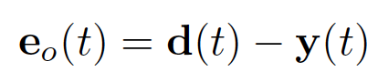
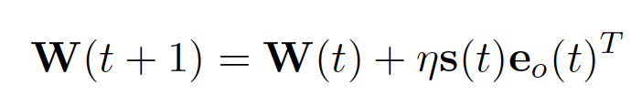
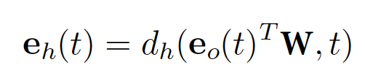
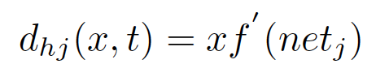
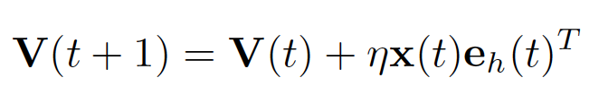
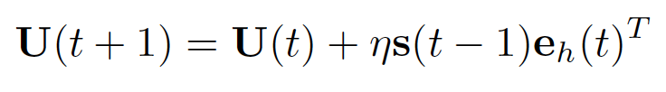
Back Propagation Through Time
Source : BackPropagation Through Time, Jiang Guo, 2013
Error (definition)
Matrix-Vector notation
Error (definition)
For output nodes:
For hidden nodes:
W change (hidden→ output )
For hidden nodes error at time t
W change (hidden→ output )
V change (input → hidden )
V change(input→hidden)
U change (hidden → hidden )
U change(hidden→hidden)

Slide 22
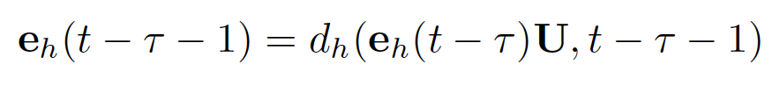
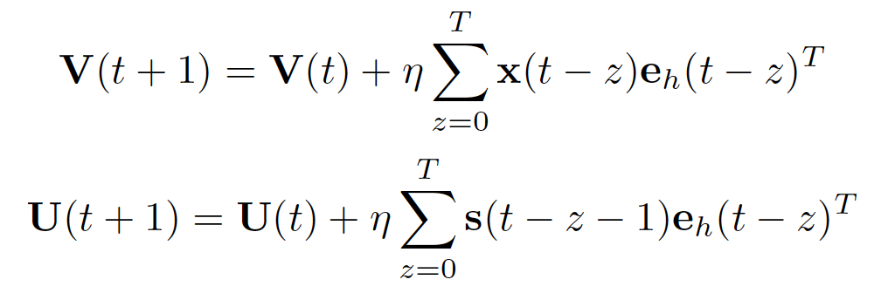
Back Propagation Through Time
Source : BackPropagation Through Time, Jiang Guo, 2013
For output nodes:
Matrix-Vector notation
For Back Propagation Through Time training,
For hidden nodes:
Matrix-Vector notation
Error (definition)
For hidden nodes error at t
V change(input→hidden)
U change(hidden→hidden)

Slide 23
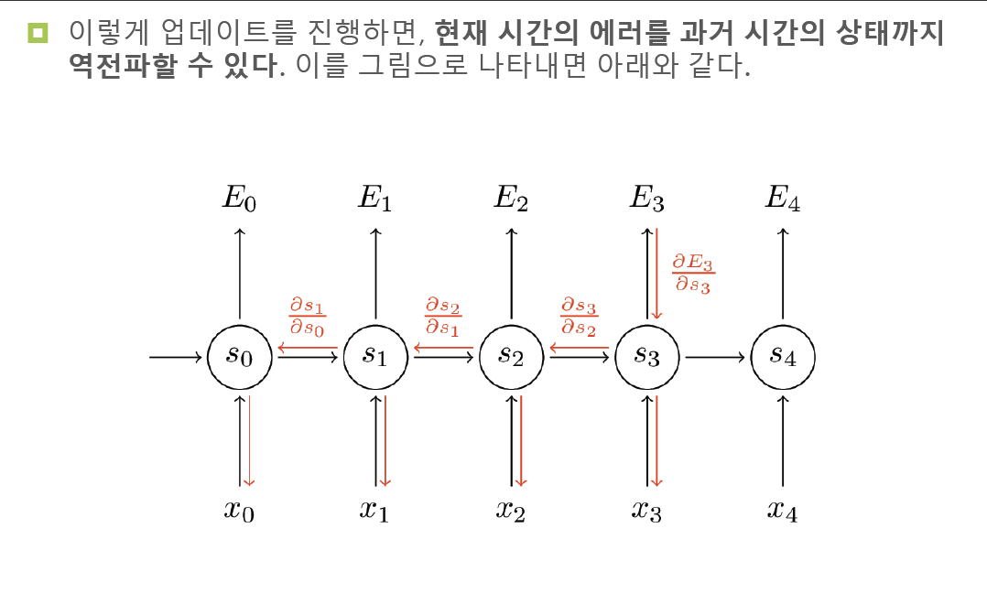
Back Propagation 을 사용하는 이유
Slide Credit : 패스트캠퍼스 –딥러닝 영상인식 강의자료 by Solaris

Slide 24
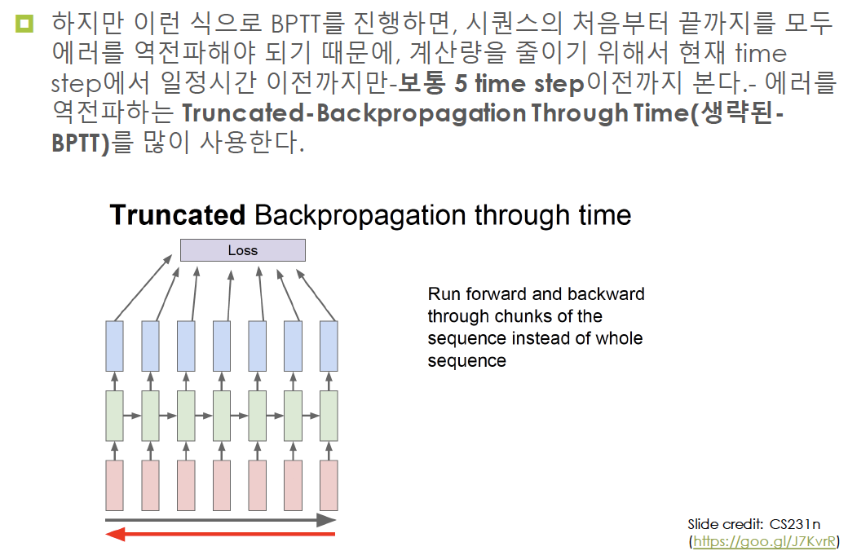
Truncated-BPTT
Slide Credit : 패스트캠퍼스 –딥러닝 영상인식 강의자료 by Solaris

Slide 25
Thank you!

